Slide 1
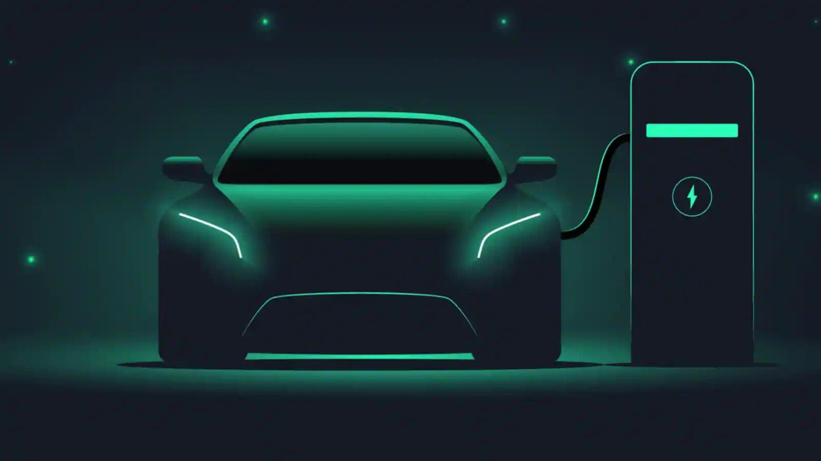
Electric Vehicle Sales by State in India
• Name: Vadla Rajashekar Chary
• Domain: Data Analyst / Machine Learning
• Tools: Python, Pandas, Machine learning, Google Colab

Slide 2
Problem Statement
Electric Vehicles (EVs) are rapidly gaining importance in India due to environmental concerns and government policies.
Understanding state-wise EV adoption trends is crucial for:
-Policy makers
-Manufacturers
-Infrastructure planners
However, EV sales data is complex and varies by:
-State
-Vehicle category
-Time period

Slide 3
Dataset Overview
Dataset Name: EV_Dataset.csv
Source: Clean Mobility Shift website
Format: CSV
Records: 96,845 rows
Features: 8 columns

Slide 4
Data Cleaning & Preprocessing
Data Cleaning Steps
Verified dataset structure and column names
Checked for:
-Missing values
-Duplicate records
Converted data types:
-Year → Integer
-Date → DateTime
Converted categorical columns for analysis

Slide 5
Exploratory Data Analysis (EDA)
EDA Objectives
-Understand EV sales growth over time
-Compare EV adoption across states
-Analyze vehicle category trends
Visualizations Performed
-Year-wise EV sales trend
-Month-wise EV sales analysis
-State-wise EV sales comparison
-Vehicle category and type analysis

Slide 6

Year-wise EV Sales Trend

Slide 7

Monthly Sales Trend

Slide 8
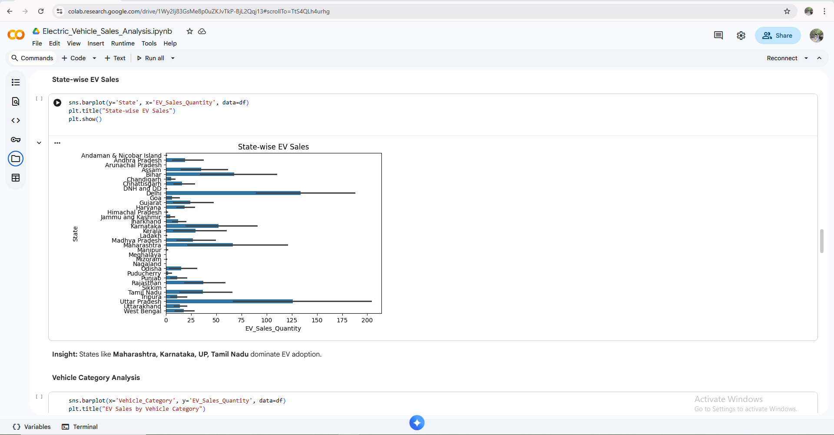
State-wise EV Sales

Slide 9
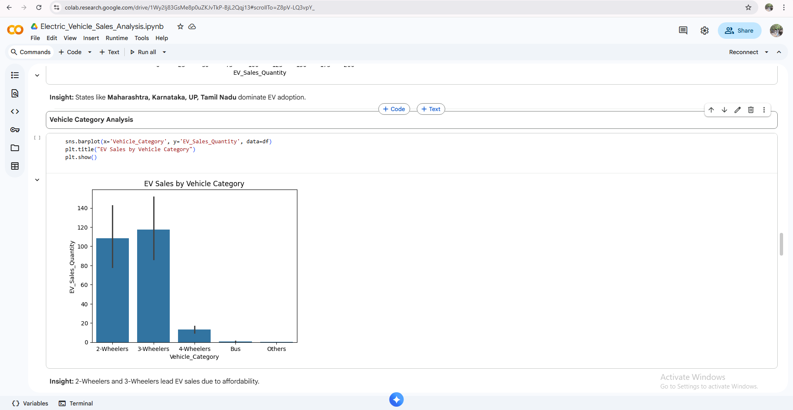
Vehicle Category Analysis

Slide 10
EDA – Key Insights
Key Observations
EV sales show significant growth in recent years
Maharashtra, Karnataka, and Uttar Pradesh lead in EV adoption
2-Wheelers dominate the EV market
Commercial and shared vehicles show rising adoption

Slide 11
Machine Learning Model
Model Used
Random Forest Regressor
Why Random Forest?
Handles large datasets efficiently
Works well with non-linear data
Provides feature importance insights

Slide 12
Model Training & Evaluation
Model Training
Dataset split:
  80% Training
  20% Testing
Model trained on historical EV sales data
Evaluation Metric
RMSE (Root Mean Squared Error)
Performance
Model accurately predicts EV sales trends
Predictions closely match actual sales values

Slide 13
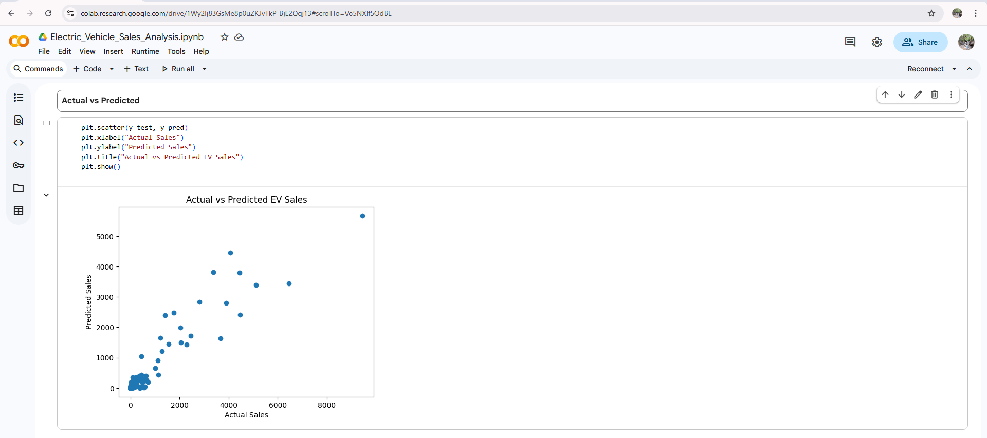
Model Evaluation
Actual vs Predicted

Slide 14

Model Evaluation
Feature Importance

Slide 15
Results & Insights
Results
State and vehicle category are the strongest predictors
EV adoption is higher in urban and industrial states
Two-wheelers contribute the most to EV sales volume
Business Value
Helps government in policy planning
Helps companies identify high-growth regions
Supports infrastructure development decisions

Slide 16
Conclusion
EV adoption in India is growing rapidly
State-wise and vehicle-wise analysis reveals clear trends
Machine Learning model successfully predicts EV sales
The project provides valuable insights for decision-makers

